Slide 1

MRI segmentation in cancer of the GI tract
By Rotem Levi and Ofek Malka

Slide 2
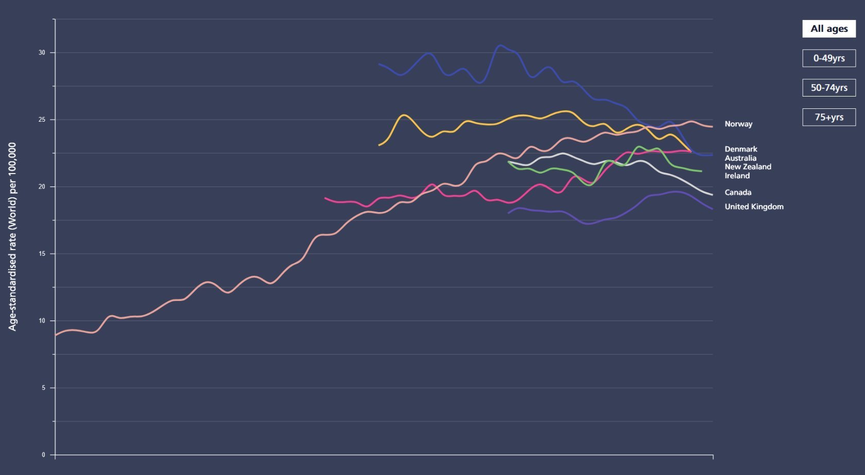
Motivation
Urgency: GI tract cancers represent over a quarter of all cancer cases affecting approximately 5 million people each year and causing an estimated 3 million deaths.
Need for precision: precise segmentation directly influences the effectiveness of radiation doses, impacting the ability to minimize damage to healthy tissues while aggressively treating cancerous areas.
Potential of AI in medical imaging: artificial intelligence, especially deep learning, has shown promising results in various fields of medicine, suggesting significant potential for revolutionizing MRI image segmentation.
Improving patient comfort and outcomes: by reducing the duration and increasing the accuracy of radiation therapy sessions, the project aims to enhance patient comfort and clinical outcomes.

Slide 3
The Problem
Limitations of current imaging technologies: the integration of MRI with radiation therapy devices (e.g., MR-Linacs) provides real-time imaging capabilities, but the process of segmenting tumors and organs is still largely manual which is
Time-consuming: it can extend treatment times significantly, often requiring up to an hour per session.
Labor-intensive: requires extensive effort from skilled radiologists.
Error-prone: subject to human error, potentially affecting treatment accuracy.
Inadequate segmentation models: existing models do not yet achieve the level of accuracy needed for effective radiation therapy within the GI tract.

Slide 4
Project Objectives
Main goal: to develop and validate a segmentation model that utilizes transformer-based architectures integrated with a U-Net model, aiming to surpass current state-of-the-art segmentation models in terms of accuracy.
Comprehensive testing: the developed model will be rigorously tested using the UW-Madison GI tract dataset, focusing on its ability to accurately segment tumor tissue as well as the stomach and intestines, providing safe margins for radiology treatments.
Performance metrics: evaluate the model’s performance based on established metrics such as the dice coefficient and Intersection Over Union (IOU), aiming for improvements over benchmarks set by current models.

Slide 5
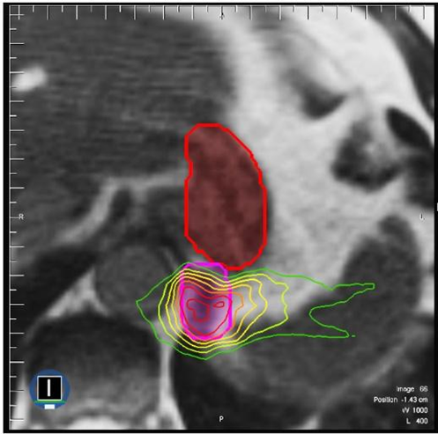
U-Net based segmentation in radiation treatment
Segmentation masks of the stomach and intestines. Pink – tumor, Red – stomach. Radiation levels shown in color gradient.

Slide 6
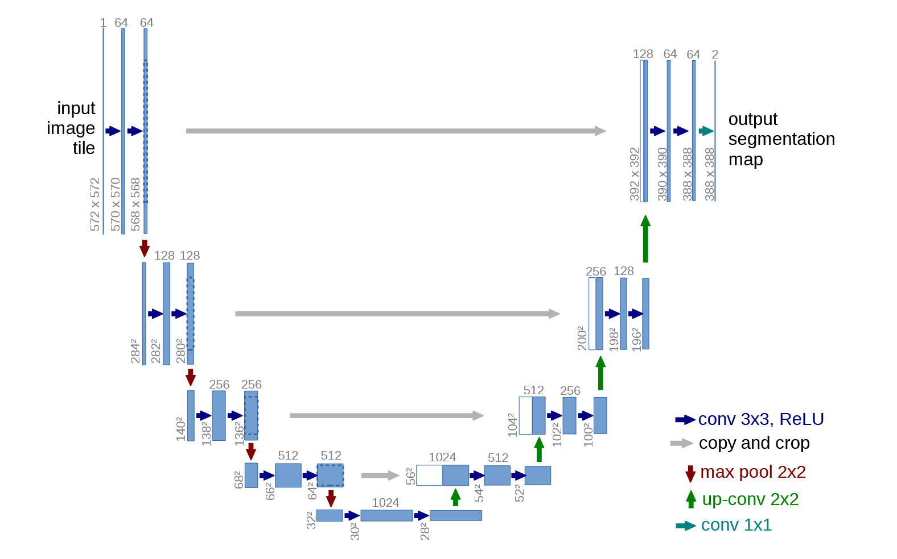
Proposed Solution
A U-Net inspired model which incorporates the transformer attention mechanism.
Notes:
Maybe: Enhance the segmentation of MRI images for GI tract cancers by developing a new model that integrates transformer-based architectures with u-net models. This approach seeks to combine the spatial relationship handling of transformers with the effective segmentation capabilities of u-net to surpass current state-of-the-art models in accuracy. The objective is to automate the segmentation process, thus increasing the precision and speed of radiation therapy planning, reducing manual effort, and improving patient outcomes by ensuring that treatments are both effective and efficient.

Slide 7
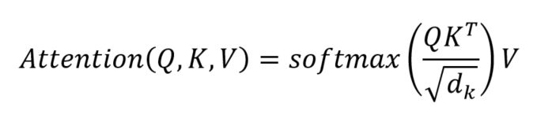
The Attention Mechanism
The Attention function mimics cognitive attention, aiming to highlight relevant regions in input data, enhancing context and relationships.
The Attention operation is used in almost all state-of-the-art U-Net variants.
First proposed in the now-famous article "Attention is all you need" in 2017, changing the ML world. ​

Slide 8
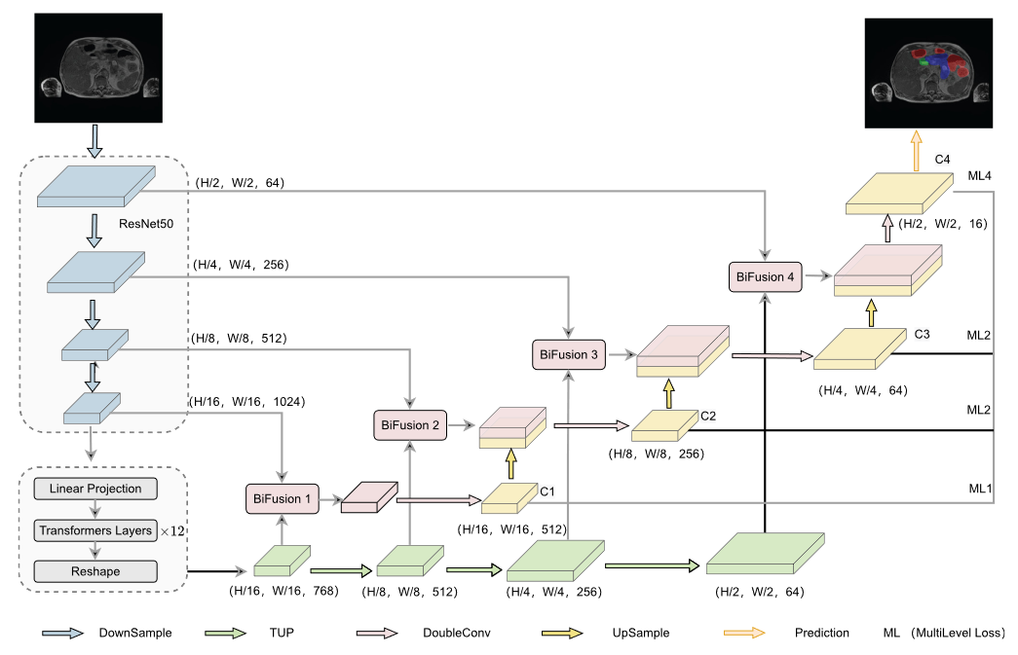
Baseline Model

Slide 9
Our Application
Using a Transformer U-Net architecture as our backbone, we will provide a user-application for simple, easy to use MRI segmentation.
The GUI system will serve as an intuitive tool for health care professionals, specifically in GI tract radiation treatment.

Slide 10
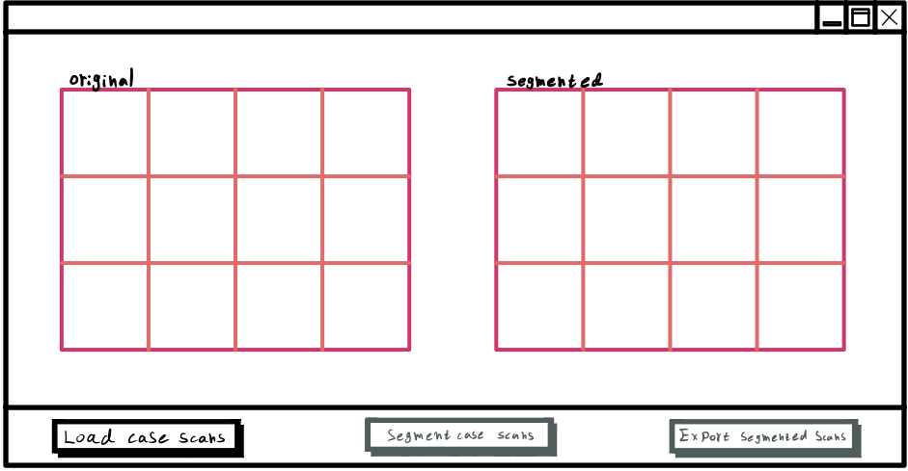
GUI
GUI at initial stage
Notes:
GUI at initial stage​
​
The only enabled button in the app is the LOAD CASE SCANS button​
Disabled button are grayed out.​

Slide 11
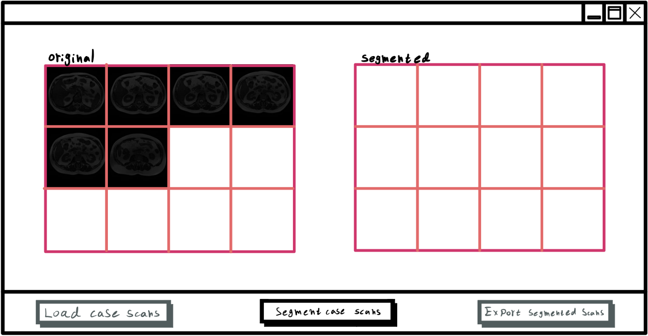
GUI
GUI at 2nd stage – MRI case scan selection
Notes:
GUI at 2nd stage ​
​
After the user used the LOAD CASE SCANS to choose the MRI scan files​
We can notice the change in which buttons are enabled and disabled​
​

Slide 12
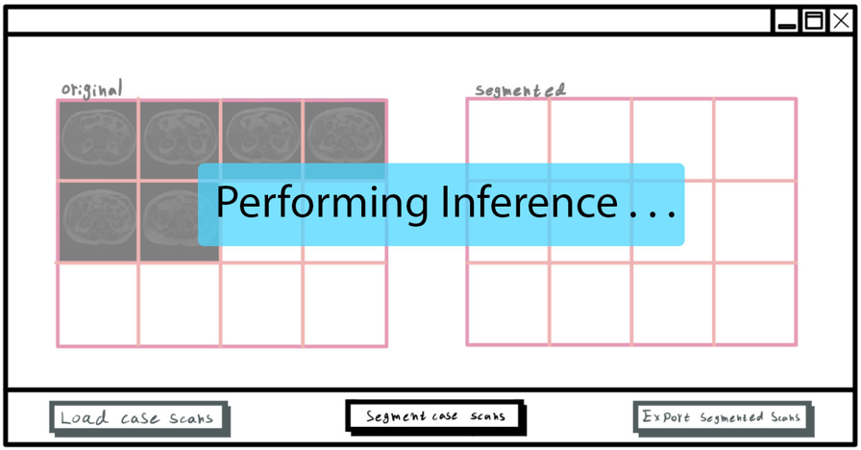
GUI
GUI paused during inference
Notes:
Once the user clicks SEGMENT CASE SCANS the app will be grayed out while the software is preforming the inference​
As we are convinced that this step might take a while, and don’t want the user to think the app crashed​
​

Slide 13
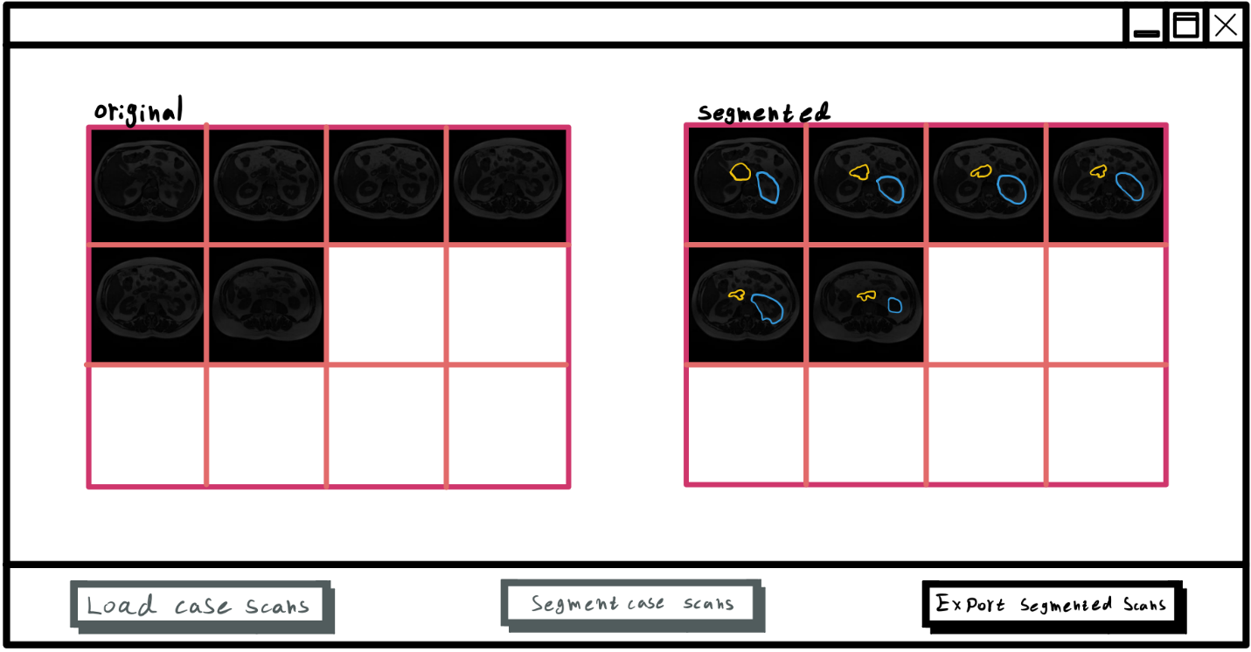
GUI
GUI at final stage – MRI case scans segmented
Notes:
After segmentation the app will be at the final stage.​
The user can choose where to export the results.​

Slide 14
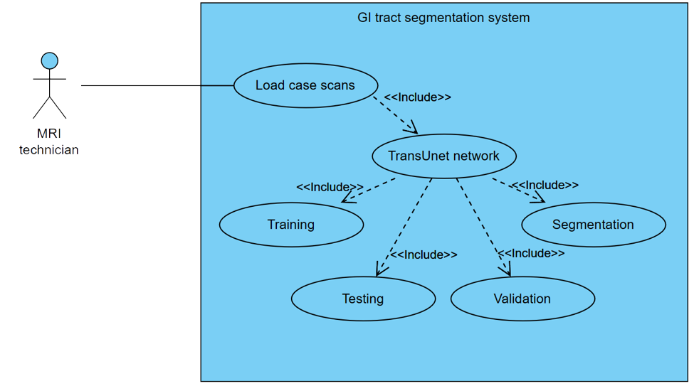
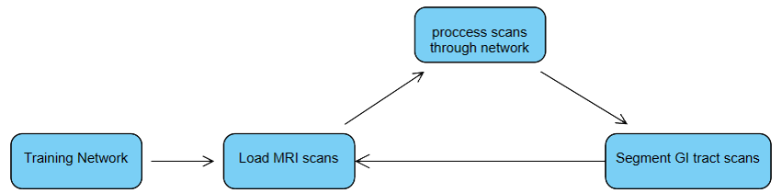
Use Case and Flow Chart Diagrams
Notes:
As for the use cases and the flow chart​
The application offer very simple interaction…?​
​

Slide 15
Testing
As success criteria for the model, we will use the IoU (intersection over union ratio), the Dice coefficient (as a measure of similarity) and the HD (Hausdorff Distance) measures. We will follow both the per-organ values and the averages. Testing GUI and user interface
Testing of the GUI and user interface as per the following table:
# | Test Case | Expected Result
1 | Click ‘Load Case Scans’ button | A file browser will pop-up, after files were chosen, GUI will advance to 2nd stage.
2 | Click ‘Segment Case Scans’ button | The GUI will cease to respond to any input, a sort of spinning wheel will appear indicating inference is taking place, once done inferencing the spinning wheel disappears and GUI advance to 3rd stage.
3 | Click ‘Export Segmented Scans’ button | A file browser will pop-up, once a folder is chosen the segmented files will be saved in that folder.
4 | Clicking on a disabled button | No action.
5 | Attempt to load unsupported image format (or non-matching dimensions) | Error message will pop-up and GUI will not advance to the next stage.
Notes:
In regards to testing and success criteria we split this topic to 2 points​
​
The model itself – that will be tested against current state-of-the-art models ​
and will be evaluated through IOU ratio, DICE coefficient, and HAUSDORFF distance.​
​
B. Second point of testing is the GUI behavior, we will test that it behave as expected according to some test cases.​
​
​

Slide 16
Our Solution's Contributions
Current methods (2024) have mostly focused on the contributions of feature-fusion components, multi-scale skip connections or additional transformer blocks – with each component implemented individually (or in pairs).
Our research aims to combine these methods in an efficient method with careful selection of hyperparameters, aiming to provide a new benchmark for GI tract MRI segmentation.
Additionally, our project will serve as a baseline for future work toward real-time medical image segmentation, with an advanced and intuitive medical GUI system.

Slide 17
Expected Achievements
Key achievements of our project:
Accuracy metrics: Superior performance via DICE and intersection over union (IoU) scores, with the aim to exceed current state-of-the-art benchmarks.
Optimized model configuration: Choosing the best hyperparameters for our model, in order to obtain the best results.
Efficient and accurate system: Deliver a robust system capable of precisely segmenting MRI images while ensuring rapid processing times, capable of meeting clinical needs within acceptable inference durations.

Slide 18
Research Challenges
Dataset quality/variability: MR image quality variations impact segmentation, these variations can be influenced by system models, manufacturers, sequence settings, and field shimming conditions. Additionally, slice-to-slice image variability (noise, artifacts) could affect segmentation accuracy.
Complex environment: The GI tract is a dense region, with overlapping organs, which requires precise analysis for successful radiation treatments.
Resources and time: Image segmentation is a delicate task, with little margin for error. Providing an automatic segmentation system which meets these demands while still able to perform a speedy inference requires a thorough understanding of the computer-vision field.
Notes:
"Before showing you our proposed method, we will now discuss the challenges we faced during the research process"...

Slide 19
Thank you!

